Slide 1

Lecture 2
TypeScript

Slide 2
Typescript is open source. Typescript simplifies JavaScript code, making it easier to read and debug. Typescript is a superset of ES3, ES5, and ES6. Typescript will save developers time. Typescript code can be compiled as per ES5 and ES6 standards to support the latest browser. Typescript can help us to avoid painful bugs that developers commonly run into when writing JavaScript by type checking the code. Typescript is nothing but JavaScript with some additional features. …
Why TypeScript?

Slide 3
Cross-platform: typescript runs on any platform that JavaScript runs on. The typescript compiler can be installed on any operating system such as windows, mac os and Linux. Object oriented language: typescript provides powerful features such as classes, interfaces, and modules. You can write pure object-oriented code for client-side as well as server-side development. Static type-checking: typescript uses static typing. This is done using type annotations. It helps type checking at compile time. Thus, you can find errors while typing the code without running your script each time. Additionally, using the type inference mechanism, if a variable is declared without a type, it will be inferred based on its value. Optional static typing: typescript also allows optional static typing if you would rather use JavaScript's dynamic typing. DOM manipulation: just like JavaScript, typescript can be used to manipulate the DOM for adding or removing elements. ES 6 features: typescript includes most features of planned ECMAScript 2015 (ES 6, 7) such as class, interface, arrow functions etc.
TypeScript features

Slide 4
Set up Development Environment
Install typescript using node.Js package manager (npm).​ Install the typescript plug-in in your IDE (integrated development environment).
npm install -g typescript
tsc -v Version blah.blah.blah
TYPESCRIPT PLAYGROUND​ Typescript provides an online playground https://www.Typescriptlang.Org/play to write and test your code on the fly without the need to download or install anything.​

Slide 5
Compile & Run TS Code
1. Create a hello.ts file (note that the TS file has a .ts suffix).​
2. Compile TS into JS: Enter the command tsc hello.ts in the terminal (at this point, a JS file with the same name will appear in the same level directory).​
3. Execute JS code: Enter the command node hello.js in the terminal
Explanation: All legitimate JS codes are TS codes, and having a JS foundation only requires learning the type of TS.
Note: The JS file generated by TS compilation does not contain type information in the code

Slide 6
TypeScript Data Type
Number
String
Boolean
Array
Tuple

Slide 7
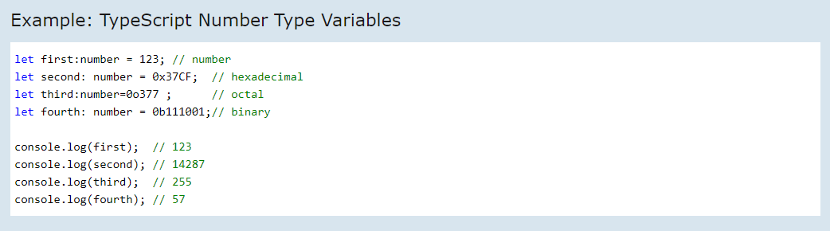
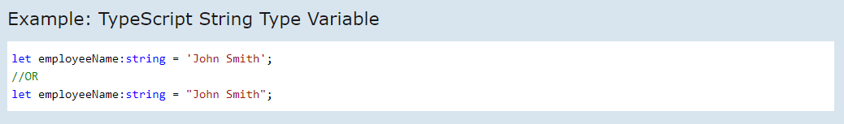
TypeScript Data Type - NUMBER
TypeScript Data Type - STRING

Slide 8

TypeScript Data Type - BOOLEAN
Note that, boolean with an uppercase B is different from boolean with a lowercase b. Upper case boolean is an object type whereas lower case boolean is a primitive type. It is always recommended to use boolean, the primitive type in your programs. This is because, while JavaScript coerces an object to its primitive type, the typescript type system does not. Typescript treats it like an object type.

Slide 9
TypeScript Data Type - Array
1. Using square brackets. This method is similar to how you would declare arrays in JavaScript.​
2. Using a generic array type, array<element type>.
Of course, you can always initialize an array like shown below, but you will not get the advantage of typescript's type system.​

Slide 10
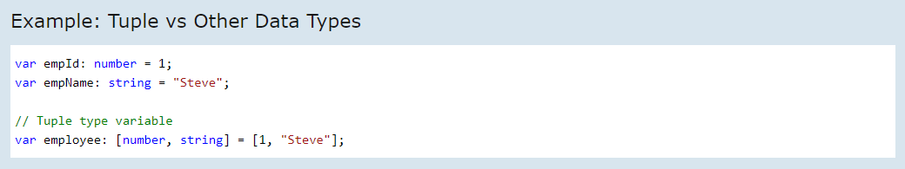
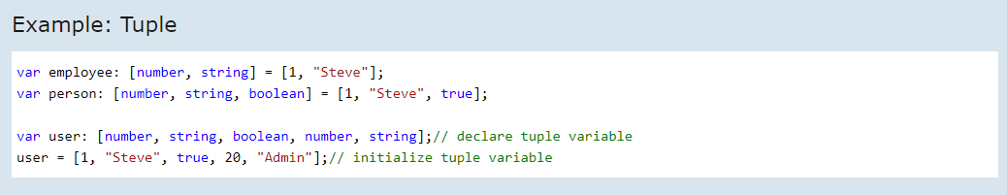
TypeScript Data Type - Tuple Typescript introduced a new data type called tuple. There are other data types such as number, string, boolean etc. In typescript which only store a value of that particular data type. Tuple is a new data type which includes two set of values of different data types.

Slide 11
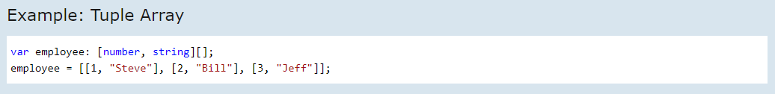
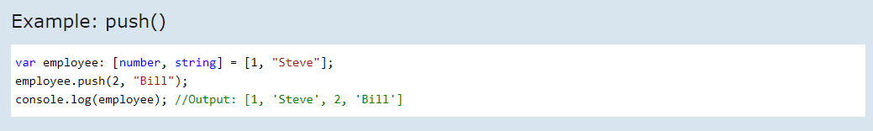
You can declare an array of tuple also.
Add Elements into Tuple

Slide 12
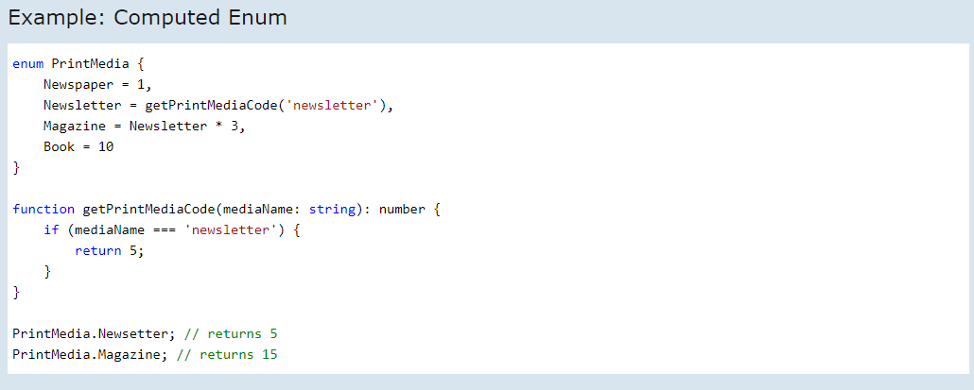
Numeric enums can include members with computed numeric value. The value of an enum member can be either a constant or computed. The following enum includes members with computed values.
When the enum includes computed and constant members, then uninitiated enum members either must come first or must come after other initialized members with numeric constants.

Slide 13


Type Assertion in TypeScript
There are two ways to do type assertion in typescript:
Using the angular bracket <> syntax.
Using as keyword
Type assertion allows you to set the type of a value and tell the compiler not to infer it. This is when you, as a programmer, might have a better understanding of the type of a variable than what Typescript can infer on its own. Such a situation can occur when you might be porting over code from JavaScript and you may know a more accurate type of the variable than what is currently assigned. It is similar to type casting in other languages like C# and Java. However, unlike C# and Java, there is no runtime effect of type assertion in Typescript. It is merely a way to let the Typescript compiler know the type of a variable.

Slide 14
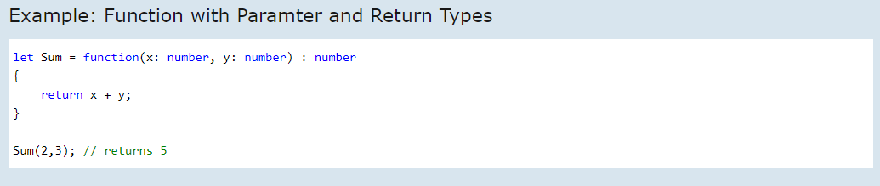
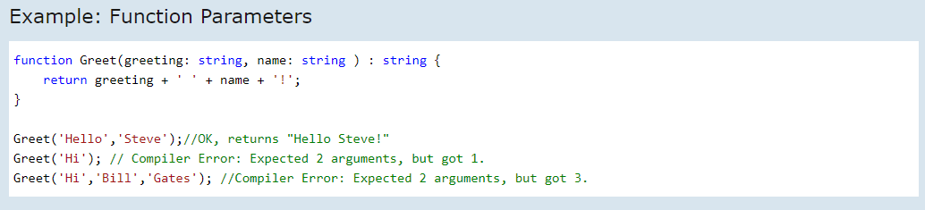
TypeScript - Function
Functions can also include parameter types and return type.
Parameters are values or arguments passed to a function. In Typescript, the compiler expects a function to receive the exact number and type of arguments as defined in the function signature. If the function expects three parameters, the compiler checks that the user has passed values for all three parameters i.e. it checks for exact matches.

Slide 15
TypeScript - Class
In object-oriented programming languages like Java and C#, classes are the fundamental entities used to create reusable components. Functionalities are passed down to classes and objects are created from classes. However, until ECMAScript 6 (also known as ECMAScript 2015), this was not the case with JavaScript. JavaScript has been primarily a functional programming language where inheritance is prototype-based. Functions are used to build reusable components. In ECMAScript 6, object-oriented class-based approach was introduced. Typescript introduced classes to avail the benefit of object-oriented techniques like encapsulation and abstraction. The class in Typescript is compiled to plain JavaScript functions by the Typescript compiler to work across platforms and browsers.
A class can include the following:
Constructor
Fields
Methods

Slide 16
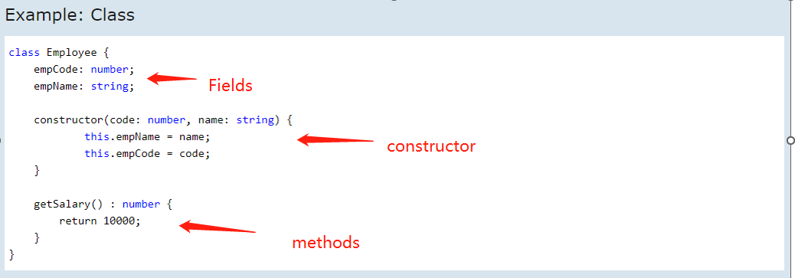
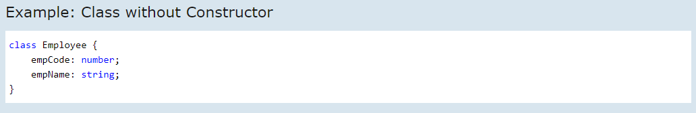
It is not necessary for a class to have a constructor.

Slide 17
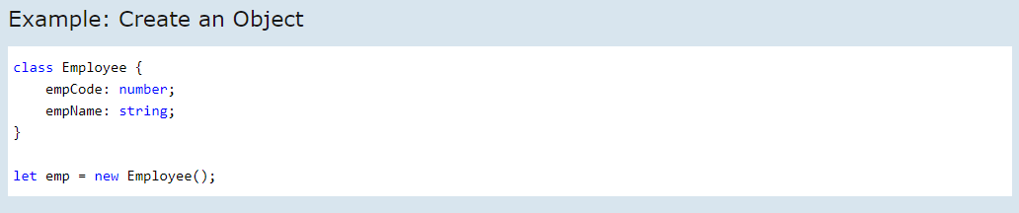
Creating an object of Class
An object of the class can be created using the new keyword.
Here, we create an object called emp of type employee using let emp = new employee();.
The above class does not include any parameterized constructor so we cannot pass values while creating an object. If the class includes a parameterized constructor, then we can pass the values while creating the object.

Slide 18
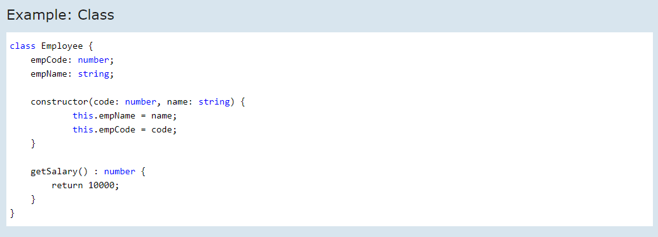
Using object's fields and methods
Here, we create an object called emp of type employee.
How to use object's fields: The fields in a class can be accessed using the dot operator (.).
How to use object’s methods: The methods in a class can be accessed using the dot operator (.).
let emp = new employee(10000, "Tony Allen");
emp.empName = "Jane Doe"
console.log(emp.empName) // Outputs: Jane Doe
console.log(emp.getSalary()) // Outputs: 10000

Slide 19
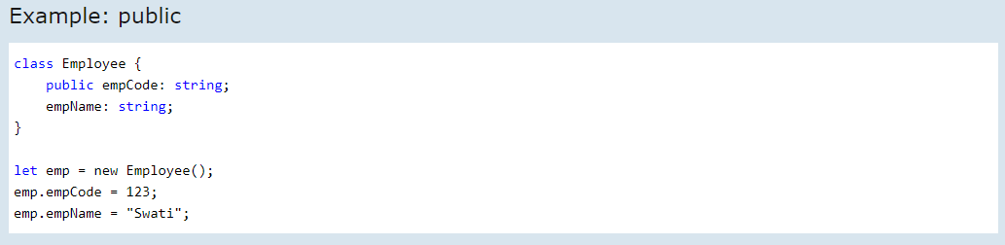
TypeScript - Data Modifiers
In object-oriented programming, the concept of 'encapsulation' is used to make class members public or private i.e. A class can control the visibility of its data members. This is done using access modifiers.
There are three types of access modifiers in typescript:
public, private and protected
Public
By default, all members of a class in Typescript are public. All the public members can be accessed anywhere without any restrictions.

Slide 20
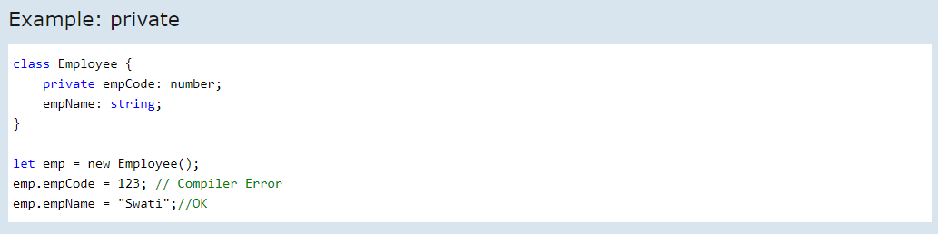
In the last example, empcode and empname are declared as public. So, they can be accessible outside of the class using an object of the class.
Please notice that there is not any modifier applied before empname, as typescript treats properties and methods as public by default if no modifier is applied to them.
private
The private access modifier ensures that class members are visible only to that class and are not accessible outside the containing class.
In the above example, we have marked the member empcode as private. Hence, when we create an object emp and try to access the emp.empCode member, it will give an error.

Slide 21
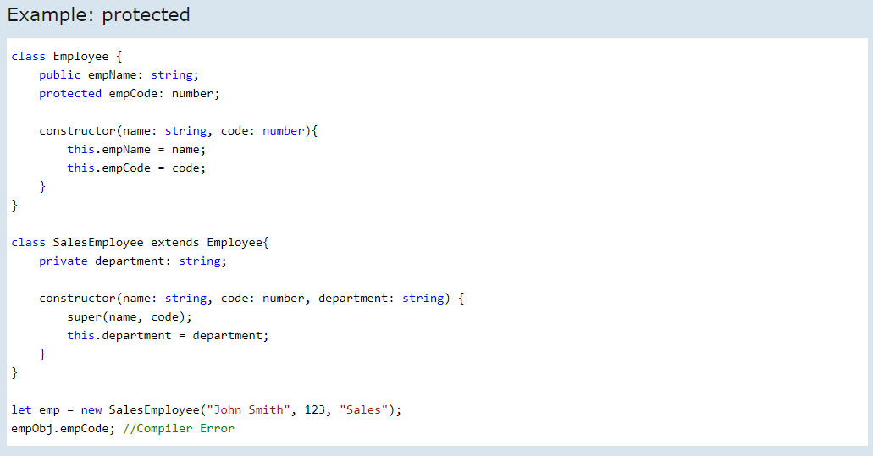
protected
The protected access modifier is similar to the private access modifier, except that protected members can be accessed using their deriving classes.

